Slide 1
The Internet Of the Things
Juan Manuel Servera
@jmservera
juanserv@microsoft.com

Slide 2
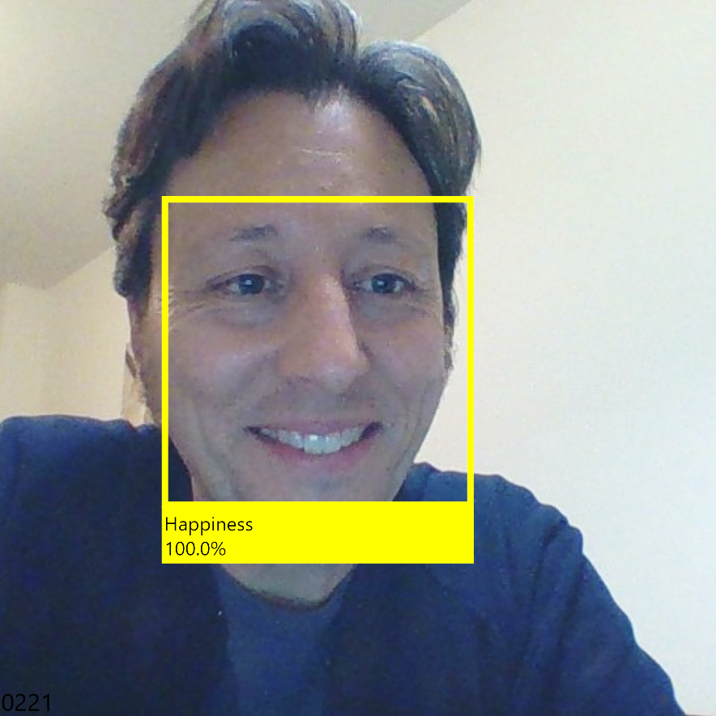
Juan Manuel Servera
Father of two
Undiscovered guitar player
.net Developer since v1.0 beta 2
C# MVP in 2014 & 2015
Level 44 geek
juanserv@microsoft.com
@jmservera

Slide 3
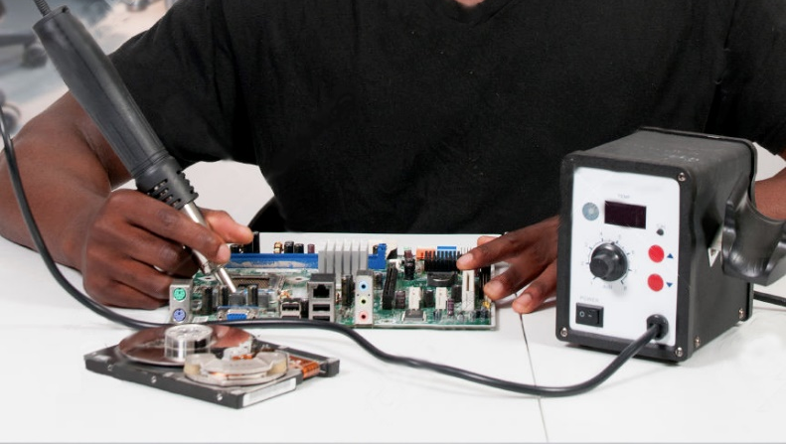

Slide 4
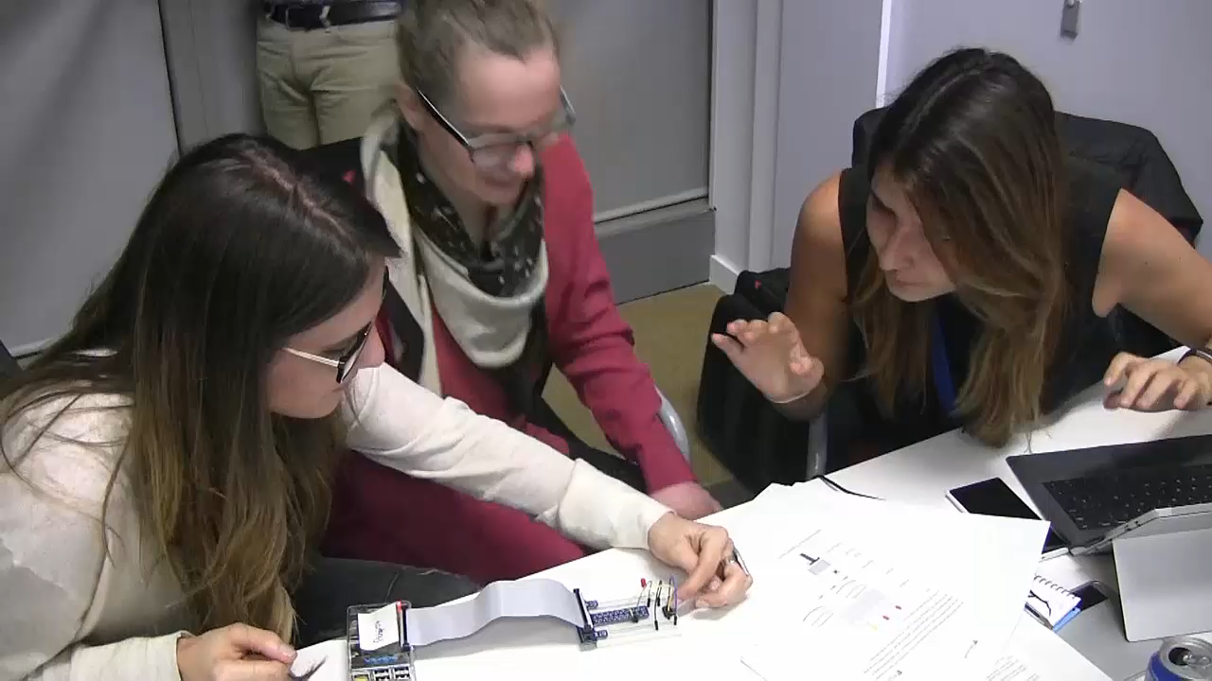

Slide 5
The Internet of the Your Things
Juan Manuel Servera
@jmservera
juanserv@microsoft.com

Slide 6
What is the Internet of (your) Things?
Things
Connectivity
Data
Analytics
Notes:
What is IoT really?
IoT really comes down to four key things:
Physical “things” such as LoB assets, devices, maker boards, and sensors
Those “things” that have connectivity to the internet, to each other, or to humans, our houses, and our vehicles.
These things have the ability to collect and communicate information – this information may include data collected from the environment or input by users
And then the analytics that comes with the data enable people or machines to take action
Getting started on the Internet of Things enables you to transform your current business and enable new growth opportunities:
IoT provides better insights to your internal, geographically dispersed operations to manage your operations, processes, asset performance and utilizations, and customer usage insights
IoT enables you to expand your business models to include proactive/predictive management and maintenance services on assets on behalf of your customers
In all industries, IoT helps you drive down costs and improve efficiency by monitoring and tracking the health of your assets
IoT helps consumers by providing insight into their houses, autos, and body

Slide 7
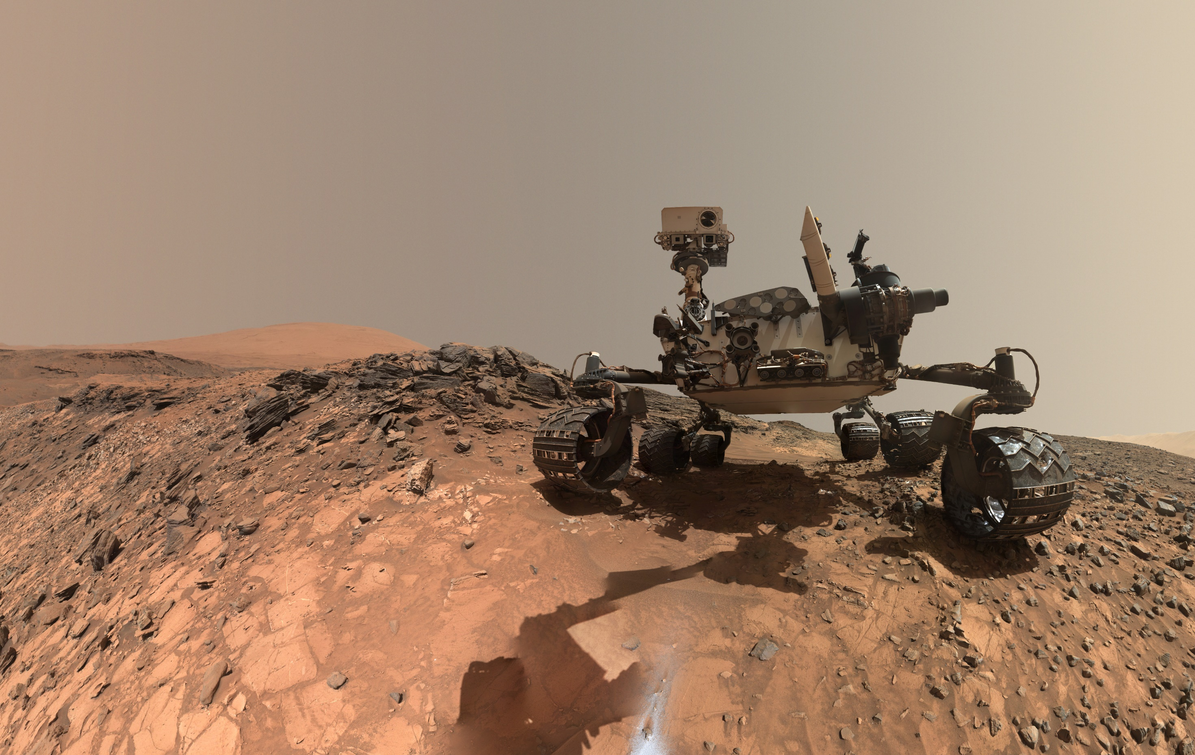

Slide 8
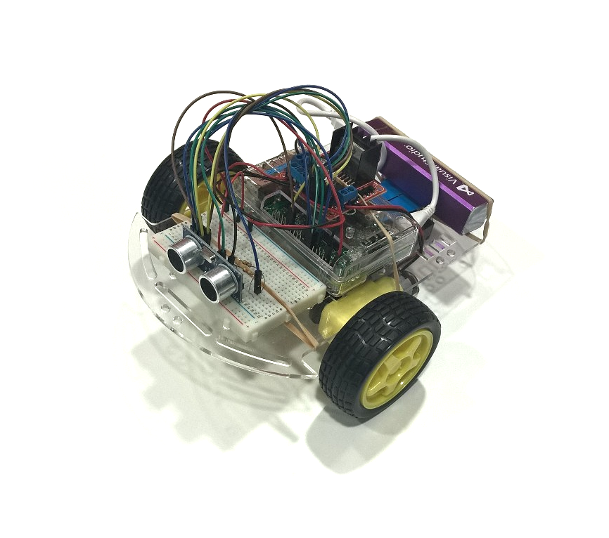
https://www.hackster.io/peejster/rover-c42139

Slide 9
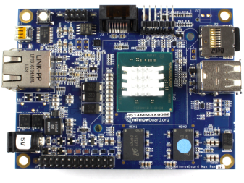
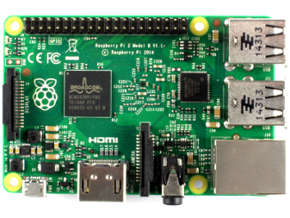
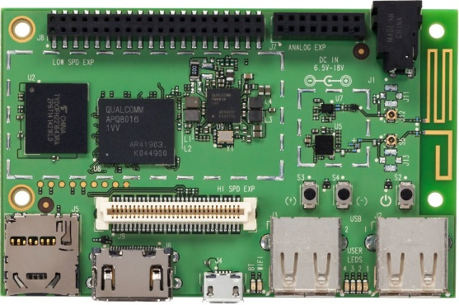
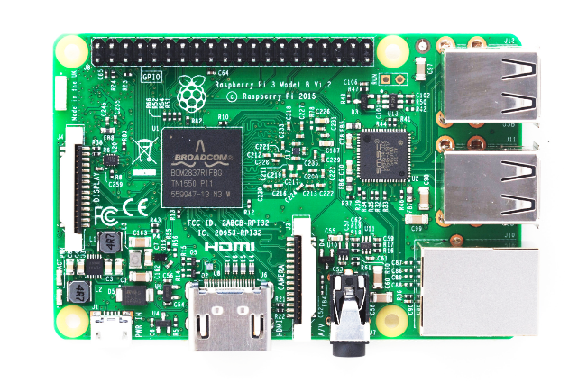
Windows 10 IoT Core
http://windowsondevices.com

Slide 10

IoT Core Basics

Slide 11
Windows Universal App Platform
One Windows Platform
Converged APIs, write ONE Universal App and target all Windows 10 editions
Scale and get higher ROI by selling same App to all Windows 10 editions OEMs/ODMSs
Reuse existing development skills
Windows Universal Platform
Common & Consistent APIs
Languages
C++ /CX
C#, VB
JS
Python*
Node.js*
UI Frameworks
HTML
Xaml
DirectX
APIs
WinRT
Win32
.NET
Wiring
Deployment and Execution
APPX
Xcopy
App Isolation
Tools
Visual Studio
PowerShell
Notes:
In Windows 10, we have the Universal App Platform (UAP) which is the programming model that covers all of our Windows 10 devices from screens in board rooms, to desktops, tablets, phones, Xbox, tiny IoT devices, and more. You can write a single application that, in binary form, can be deployed across every device.
Across all of those devices you can use the same programming model and languages, making it simple to scale applications from tiny devices to multi-core 64 bit Intel monster workhorses.

Slide 12
Demo Windows 10 IoT Core
Notes:
Red=17
Yellow=4

Slide 13

Microsoft’s view
The Internet of Things starts with your things.
Build on the infrastructure you already have
Add more devices to the ones you already own
Get more from the data that already exists
Stop just running your business. Start making it thrive. Start realizing the potential of the Internet of Your Things.
.
Notes:
Key goal of slide::
Land Microsoft’s unique and differentiated point-of-view on the Internet of Things: the Internet of Your Things.
Microsoft believes the Internet of Things doesn’t have to be overwhelming. Businesses can start small, with a few changes that make a big impact. It’s not about the billions of things that can be connected, it’s about YOUR THINGS. And, it’s already happening!
Slide talk track:
The Internet of Your Things is not about ripping and replacing technologies in your enterprise. It’s about leveraging what you have, adding on to your existing systems, using your existing things in new ways, and innovating and optimizing so everything works better together. If you’re a retailer, think about how smarter POS terminals can increase cross-selling and up-selling. If you’re in healthcare, think about how connecting patient monitors, tablets, signage and other equipment can streamline patient care. For manufacturers, sensors on the factory floor can “talk” to diagnostic monitors to improve production efficiency and reduce down time.
The Internet of Things starts with your things. It is about the things that matter most to your business.
Build on the infrastructure you already have.
Connect the devices you already own…then add to your existing investments.
Tap into the data that already exists.
The Internet of Your Things is about getting away from spending all your time just running your business, and thinking about finding ways to make it thrive. Start realizing the potential of the Internet of Your Things.

Slide 14












Microsoft Azure services for IoT
Producers | Data Transport | Storage | Analytics | Presentation & action
 | Event Hubs (Service Bus) | SQL Database | Machine Learning | Azure Websites
 | Heterogeneous client agents | Table/Blob Storage | HD Insight | Mobile Services
 | External Data Sources | DocumentDB | Stream Analytics | Notification Hubs
 |  | External Data Sources | Cloud Services | Power BI
 |  |  |  | External Services
{ }
Notes:
As we think about Azure services for IoT, there are a collection of capabilities involved.
First there are Producers. These can be basic sensors, small form factor devices, traditional computer systems, or even complex assets made up of a number of data sources.
Next we have the Data Transport capabilities on the ingress level within and around Azure. The primary destination is Service Bus Event Hubs, but this relies on client agent technology either at the edge device level or within a field or cloud gateway. We also have capabilities for other external data sources o provide data (eg: TKA, LU)
As data is brought into Azure, there are various Storage options there can be a number of destinations engaged. Traditional database technology, table or blob, or even more complex destinations like Document DB are possible. External or third party technologies can also be used. This is where the flexibility and agility of a platform shows its strength, This is where analysts like Gartner are forming opinions about just how robust our platform can be.
As this data is processed in Azure, there are a number of capabilities that can be utilized. Machine Learning, HD Insight, Stream Analytics are examples of tools that can process the data in various ways.
Finally the concept of data presentation uses Azure services. Data may populate a LOB portal, be pushed to apps, or presented in analytics and productivity tools. These are all ways that the data gets out of these architecture points to allow organizations to use analysis to change / transform their business.
Through all of these areas, there is the possibility of utilizing existing investments either within your Azure environment, or elsewhere.

Slide 15
The Connect the Dots lab http://connectthedots.io

Slide 16
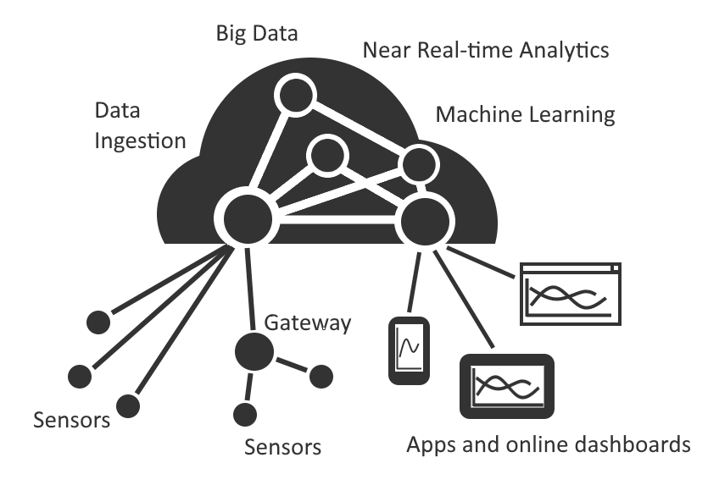
Example Solution
Notes:
Here’s one example of using Azure for IoT
In this particular approach:
Sensors talk to a gateway which is then responsible for forwarding to Azure
Some sensors which have networking built-in, can talk directly to Azure
The data from all of those sensors is processed by the analytics and machine learning. Through those, we can use the data to inform our actions
Apps on phones, tablets, and PCs, can then look at the results

Slide 17
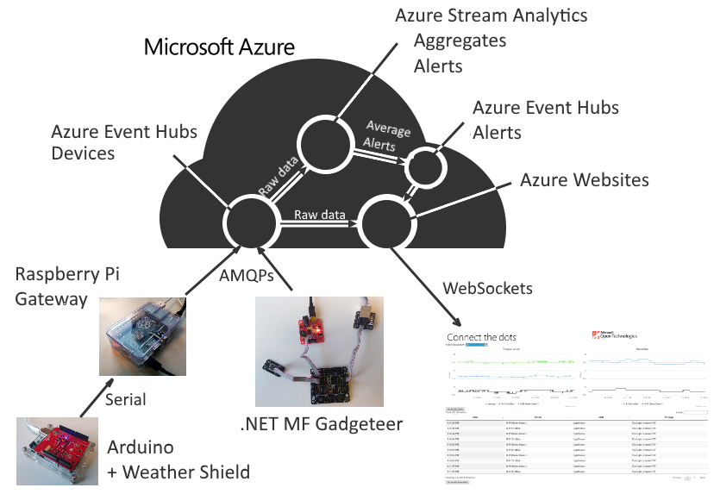
ConnectTheDots Solution
Notes:
Be sure to make the following points:
This is one example solution
This isn’t necessarily a recommended architecture or a blueprint
Devices like Gadgeteer/NETMF (or Windows) can talk directly to Azure
Other devices, like Arduino, work best when connected to a gateway. In this case, we use the Raspberry Pi to connect with Azure.
In both cases, we use the AMQPs protocol. That’s not the only protocol supported, but it’s a good one to use here.
Finally, we use the Azure Website to show a dashboard based on the data ingested through the event hubs and processed through stream analytics
For our lab today, we’ll support:
.NET Gadgeteer
Raspberry Pi (Linux) with Arduino.
As the products are released, we’ll also incorporate Windows 10 Athens into the solution – something you will be able to try on your own should you desire.

Slide 18
Enlaces interesantes
https://github.com/esmsdn/ProfesoresTecnologia
http://windowsondevices.com
http://connectthedots.io
http://thinglabs.io
http://microsoft.hackster.io
http://desarrollaconmicrosoft.com/estudiantes

